Slide 1
High school applications

Slide 2
What is my first step
You should have gone to the open house for Erie High or Collegiate Academy….
Erie High cancelled open house!
Collegiate will have a presentation on the website, watch before you complete your application.

Slide 3
Deciding on a school
Collegiate Academy Academic track
Collegiate Academy Magnet track
Erie High Academic track
Erie High Career and Tech lab

Slide 4
online application collegiate academy
1. Erie School District Website: eriesd.org
2. Click on Schools and scroll down
3. Click on Northwest Pennsylvania Collegiate Academy
4. Click on Applications and Forms
5. Left hand side click on Online Application for Admission

Slide 5
online application collegiate magnet program
1. Erie School District Website: eriesd.org
2. Click on Schools and scroll down
3. Click on Northwest Pennsylvania Collegiate Academy
4. Click on Magnet School
5. Left hand side click on Online Application for Admission

Slide 6
online application erie high school
1. Erie School District Website: eriesd.org
2. Click on Schools and scroll down
3. Click on Erie High School
4. Click on Applying
5. Left hand side click on Application

Slide 7
information you will need when applying
1. 7th grade Final grades in ELA, Algebra II, Science, Social Studies
2. 8th grade1st quarter grades in ELA, Algebra II, Science, Social Studies
3. PSSA Scores
4. Teachers email address for a recommendation
5. List of activities, Services and Awards

Slide 8
But Ms. Peck where do I get that information
The Student Portal

Slide 9
student portal
1. eriesd.org click on student
2. Click on Infinite Campus then campus student
3. Lunch number and password
4. 7th grade final grades- Left of page lick DOCUMENTS then click PORTAL TRANSCRIPT
5. 8th grade 1st quarter grades-Left of page click on GRADES

Slide 10
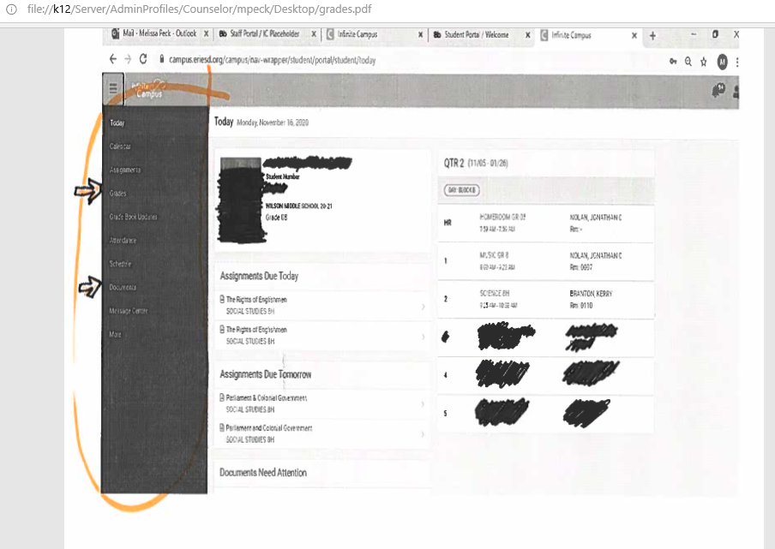

Slide 11
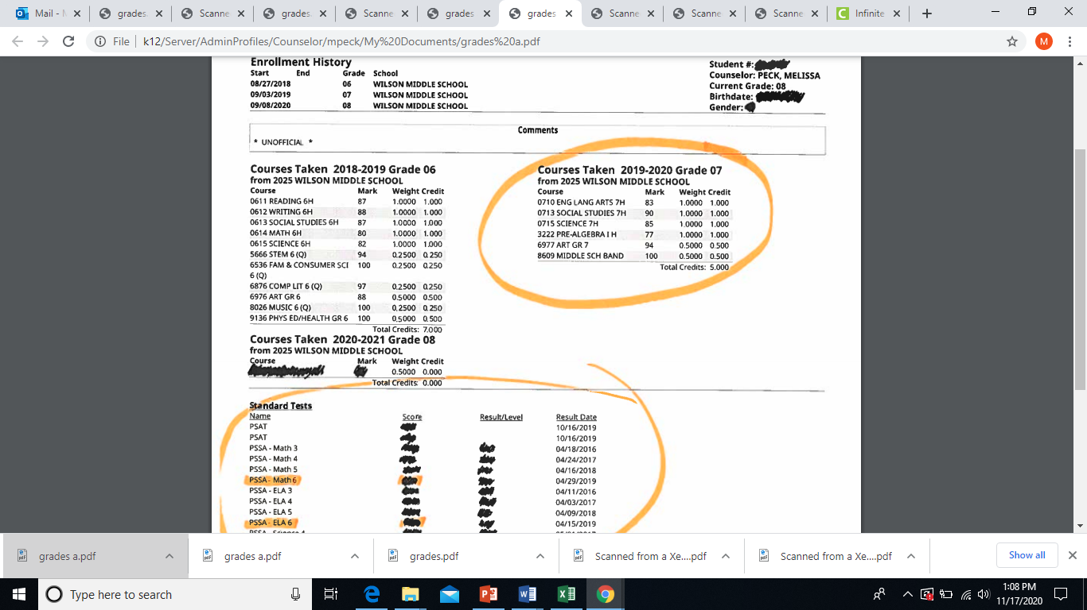

Slide 12
student portal
6. If you need PSSA scores SCROLL to the bottom of your 7th grade transcript.
7. When applying to Collegiate…leave PSSA spot blank.

Slide 13
other information you should just know
1. A Parent Phone Number
2. A Parent email address
3. Your address
Wilson Middle School
718 East 28th Street
Erie, Pa 16504

Slide 14
what happens next
You will receive letters in the mail of your acceptance.
Included in the Collegiate Acceptance will be a date for a scheduling night. You will schedule your 9th grade classes.
Erie High 9th grade scheduling in the past has occurred at Wilson. It will probably look a little different this year.

Slide 15
Wilson teacher emails
Teachers email will be listed on the next few slides.
I left teachers names that were in the building last year but moved to a different building.

Slide 18
congratulations
Questions?

